Slide 1
Finite Automata with Outputs
Last PART

Slide 2
Contents
Finite automata with outputs
Mealy machine
Moore machine

Slide 3
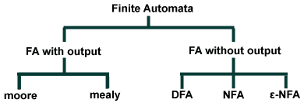
Finite Automata

Slide 4
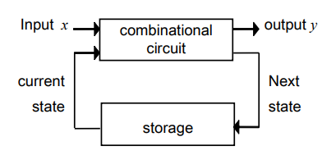
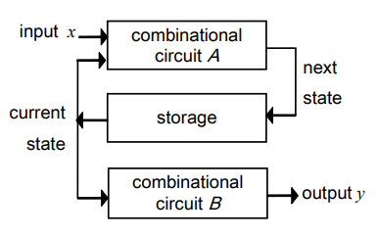
Finite Automata with outputs
Mealy machine model whose output depends on both the input and the current state of the machine.
Moore machine model whose output depends only on the current state of the machine.

Slide 5
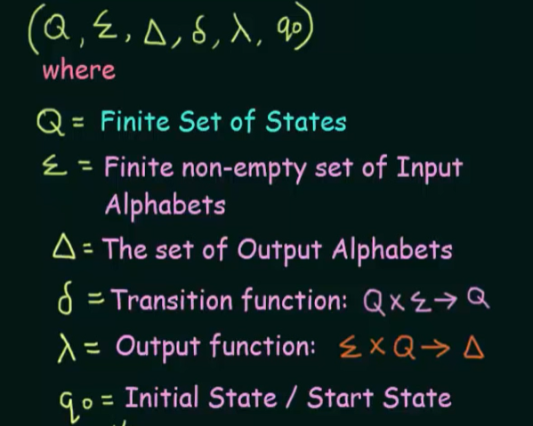
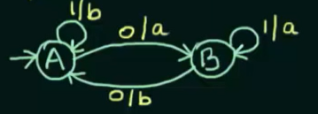
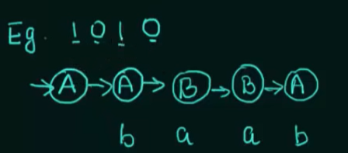
Mealy Machine

Slide 6
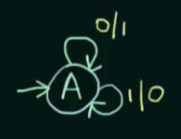
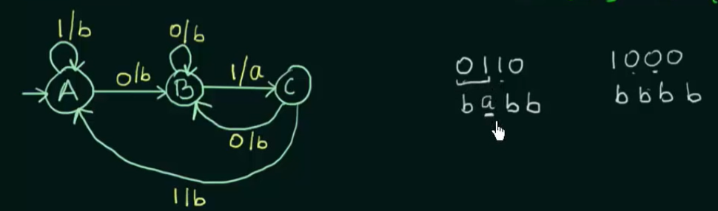
Construction of Mealy Machines
Example 1: Construct a mealy machine that produces the 1’s complement of any binary input string.
Example 2: Construct a mealy machine that prints ‘a’ whenever the sequence ’01’ is encountered in any binary input string.

Slide 7
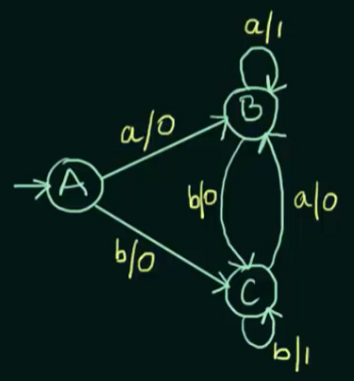
Contd…
Example 3: Construct a mealy machine that accepting the language consisting of strings from Ʃ*, where Ʃ={a,b} and the strings should end with either aa or bb.

Slide 8
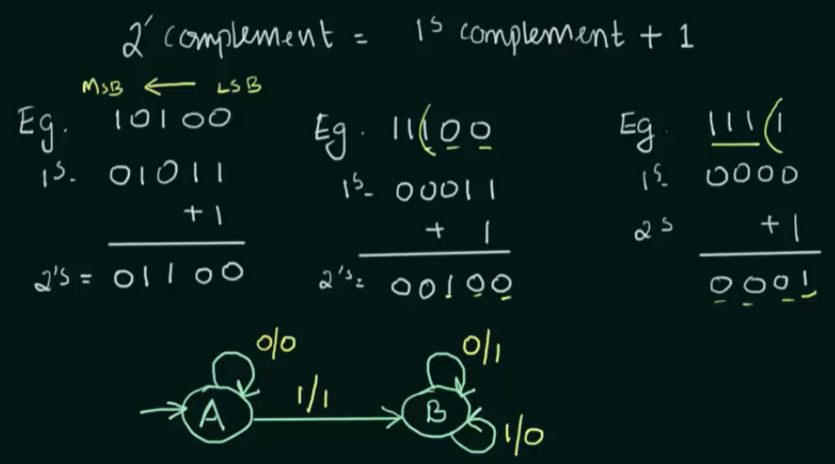
Contd…
Example 4: Construct a mealy machine that gives 2’s complement of any binary input. (Assume that the last carry bit is neglected)

Slide 9
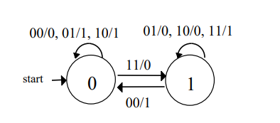
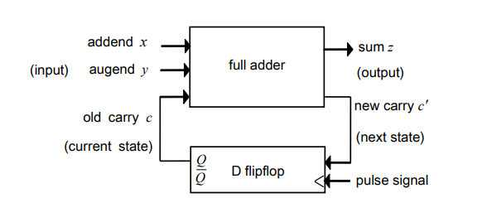
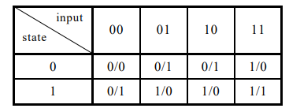
Contd…
Example 5: Serial adder or Full adder.

Slide 10
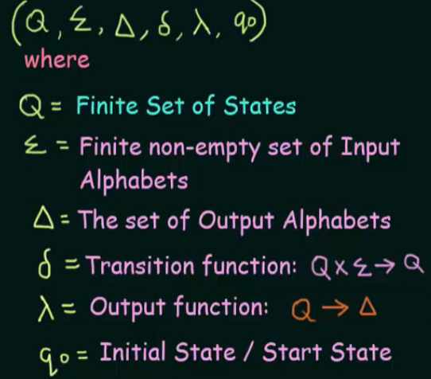
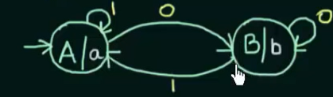
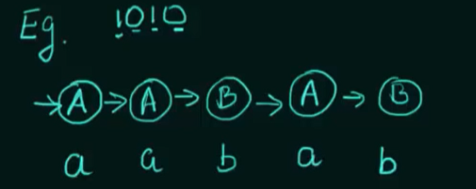
Moore Machine

Slide 11
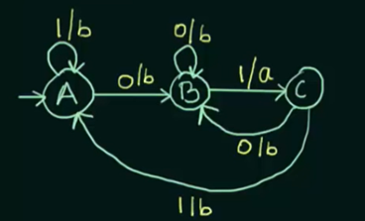
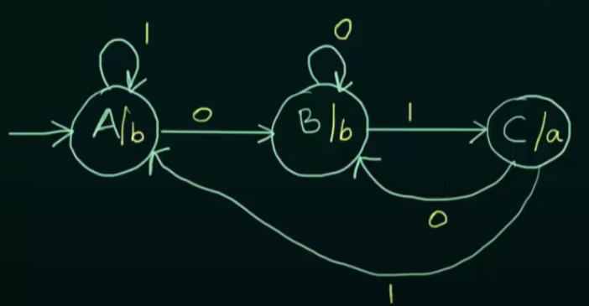
Construction of Moore Machine
Example 1: Construct a moore machine that prints ‘a’ whenever the sequence ’01’ is encountered in any binary input string.
Here Ʃ={0,1} and Δ={a,b}

Slide 12
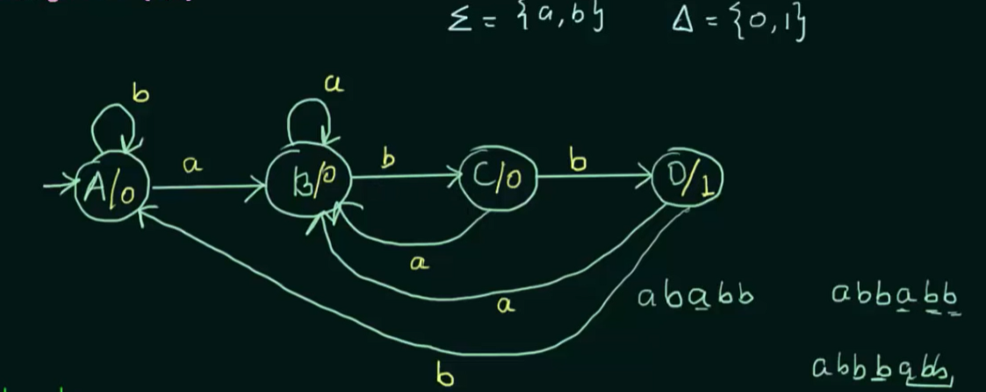
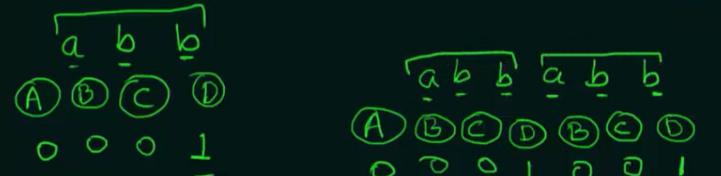
Contd…
Example 2: Construct a moore machine that counts the occurrences of the sequence ‘abb’ in any input strings over {a,b}

Slide 13
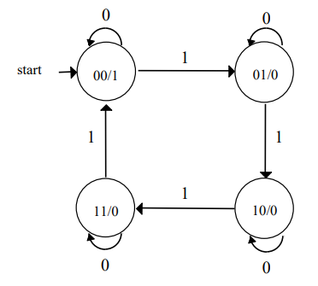
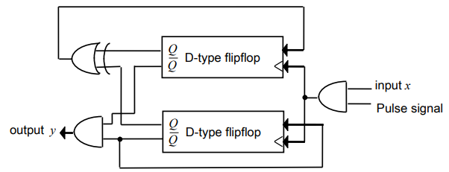
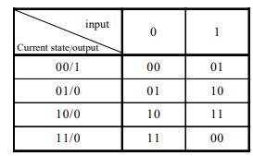
Contd…
Example 3: 2-bit binary counter

Slide 14
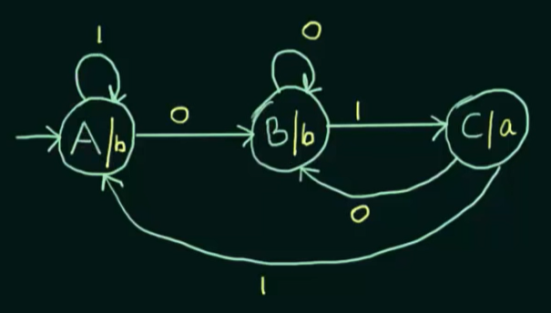
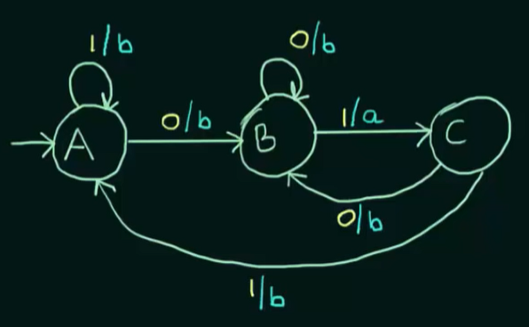
Conversion of Moore machine to Mealy machine
Example 1: Construct a Moore machine that prints ‘a’ whenever the sequence ‘01’ is encountered in any input binary string and them convert it to its equivalent mealy machine.

Slide 15
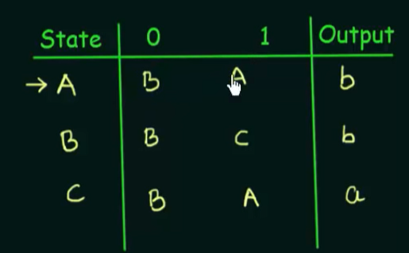
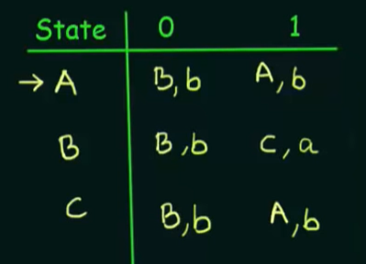
Contd…

Slide 16
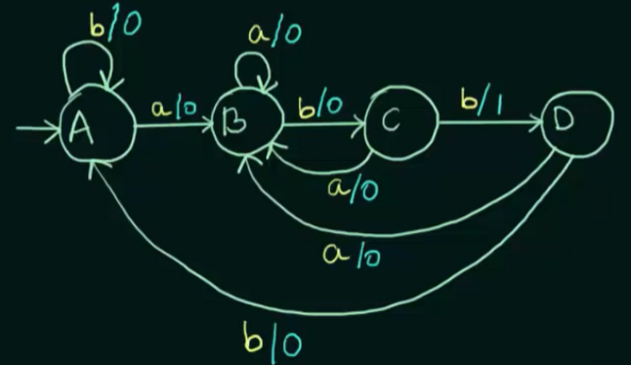
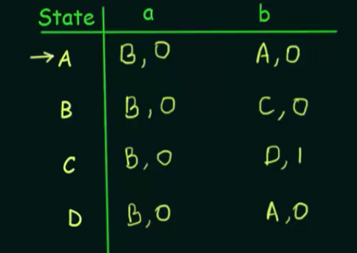
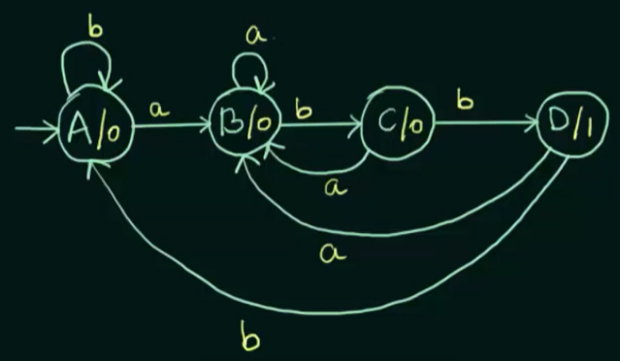
Contd…
Example 2:

Slide 17
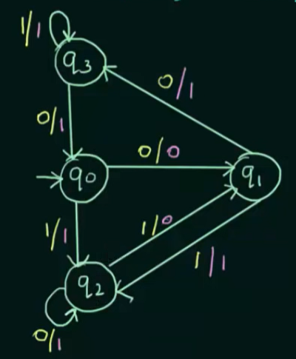
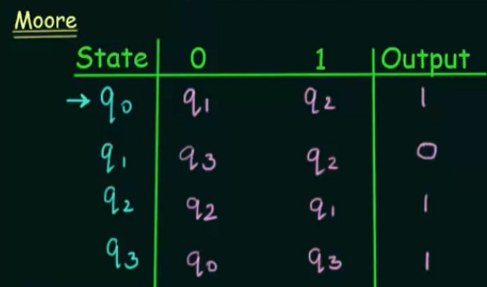
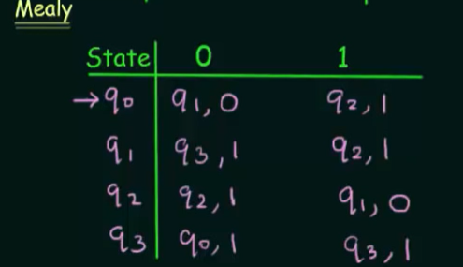
Contd…
Example 3: Convert the given Moore machine to its equivalent Mealy machine.

Slide 18
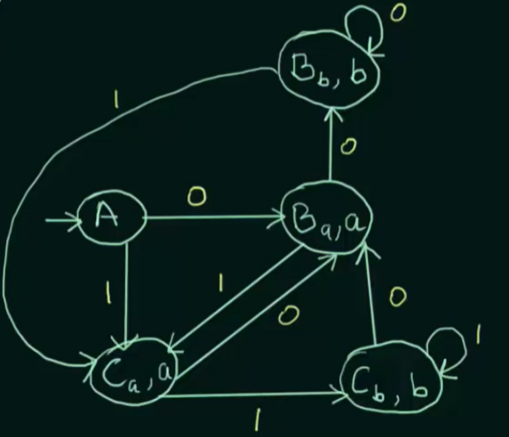
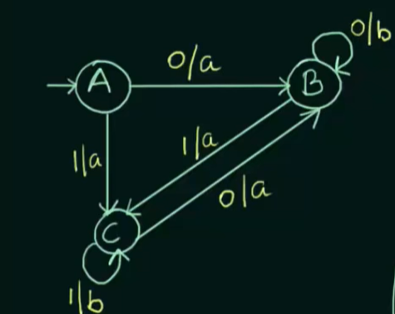
Conversion of Mealy machine to Moore machine

Slide 19
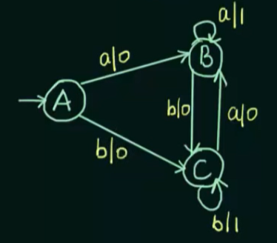
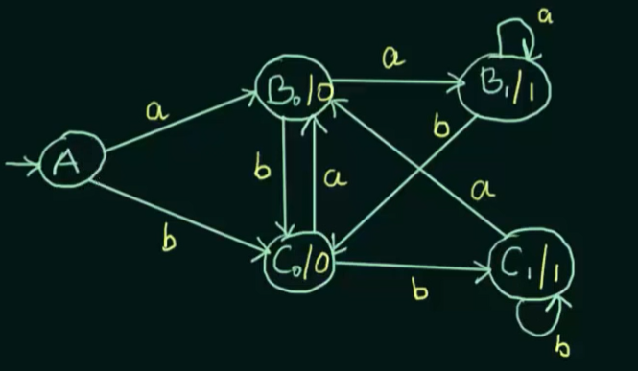
Contd…
Construct a mealy machine that prints ‘1’ whenever the sequence ‘aa’ or ‘bb’ is encountered in any input binary string from from Ʃ*, where Ʃ={a,b} .

Slide 20
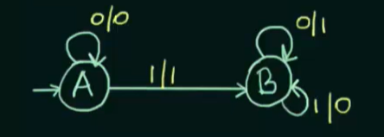
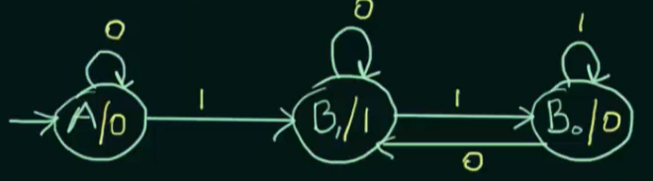
Contd…
Convert the given mealy machine that give the 2’s complement of any binary input to equivalent moore machine.

Slide 21
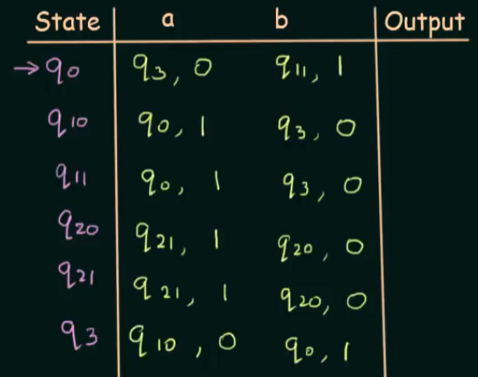
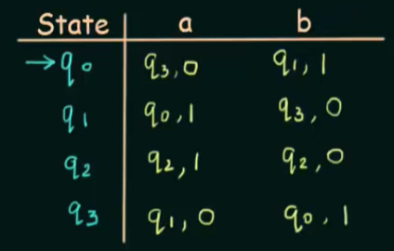
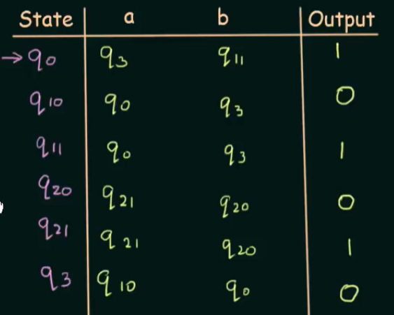
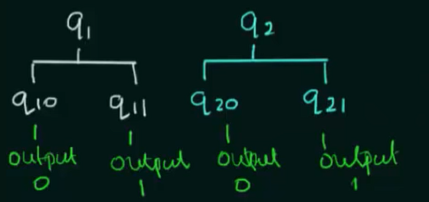
Contd…. (using transition table)

Slide 22
Observations
Moore -> Mealy => No of states were same
Mealy -> Moore => No of states increases
If Mealy machine has x (number of states) and y(number of outputs) => (x x y) number of states at maximum.

Slide 23
Thank you!!

